Slide 1
BSIT-5th

Slide 2
Markets
Meaning of Market:
Ordinarily, the term “market” refers to a particular place where goods are purchased and sold. But, in economics, market is used in a wide perspective. In economics, the term “market” does not mean a particular place but the whole area where the buyers and sellers of a product are spread

Slide 3
According to Prof. R. Chapman, “The term market refers not necessarily to a place but always to a commodity and the buyers and sellers who are in direct competition with one another.”
In the words of A.A. Cournot, “Economists understand by the term ‘market’, not any particular place in which things are bought and sold but the whole of any region in which buyers and sellers are in such free intercourse with one another that the price of the same goods tends to equality, easily and quickly.”
Prof. Cournot’s definition is wider and appropriate in which all the features of a market are found.

Slide 4
Types of Markets/Forms of Market Structure:
Perfect Competition: A very large number of firms sell to a very large number of consumers. Firms make an identical product, and consumers are perfectly informed about prices and quantities. An example might be a fruit and veg market.
Imperfect Competition:
The imperfect competition is the situation of market failure in which, unlike the situation of perfect competition, the law of supply and demand is not freely used to determine prices, but in which there must be a balance in the prices determined.
In a situation of imperfect competition, the firms may have sufficient market power to affect the price of the market. The main consequences of such market power are a negative impact on consumer welfare and a loss of efficiency.

Slide 5
In economics theory, imperfect competition is a type of market structure showing some but not all features of competitive markets
Imperfect competition comprises the following types of markets structures:
Monopolistic competition
Monopoly,
Oligopoly/Duopoly
Monopsonies and
Oligopsonies.

Slide 6
Monopoly:
There is only one offerer and a plurality of buyers; it is a firm with no competitors in its industry. The monopolist has market power, that is, it can influence the price of the good. A pure monopoly is the only firm selling in a market, and there may be high entry or exit costs. Monopolies will produce less for a higher cost. Consumers will get worse welfare under monopoly, and society as a whole will take some part of the loss – a deadweight loss.
Oligopoly:
When a market is supplied by a small number of firms (more than 2), being each of them responsible to produce a significant fraction of the total output.
Oligopolies are markets where there are only a few competitors, and probably high entry costs. Oligopolies will tend to produce more than monopolies but less than forms in perfect competition – the result depends on how firms compete with each other.
Duopoly:
A special form of Oligopoly, with only two firms in an industry. It is a particular case of oligopoly, so it can be said that it is an intermediate situation between monopoly and perfect competition economy.

Slide 7
Monopolistic Competition:
In a monopolistically competitive market firms make different products from each other. As a result they behave like monopolies in the short run and competitive firms in the long run. Firms in monopolistic competition have to consistently invest in their product to keep themselves making higher profits.

Slide 8
Monopsony
A market with a single buyer and many sellers. In opposite to a monopoly, a monopsony has a demand with monopolistic power, instead of the supply. When there is only one or a few buyers, some buyers may have monopsony power, which is the ability of a buyer to influence the price of an asset. Monopsony power allows the buyer to acquire the good at a lower price than would be the case in a competitive market.
Even though this type of market structure can’t be found so easily in real world, some coal companies are considered to be monopsonies
Oligopsony:
A market with a few buyers and many sellers. Contrasting with the concept of oligopoly, oligopsony has the influencing power on the buyers side, once they are in fewer number, in comparison with the suppliers. The Tobacco industry is an example of this type of market structure.

Slide 9
Characteristics of Perfect Competition:
Large Number of Buyers and Sellers:
The first condition s that the number of buyers and sellers must be so large that none of them individually is in a position to influence the price and output of the industry as a whole. In the market the position of a purchaser or a seller is just like a drop of water in an ocean.
. Homogeneity of the Product:
Each firm should produce and sell a homogeneous product so that no buyer has any preference for the product of any individual seller over others. If goods will be homogeneous then price will also be uniform everywhere.
Free Entry and Exit of Firms:
The firm should be free to enter or leave the firm. If there is hope of profit the firm will enter in business and if there is profitability of loss, the firm will leave the business.
Perfect Knowledge of the Market:
Buyers and sellers must possess complete knowledge about the prices at which goods are being bought and sold and of the prices at which others are prepared to buy and sell. This will help in having uniformity in prices.
Perfect Mobility of the Factors of Production and Goods::
There should be perfect mobility of goods and factors between industries. Goods should be free to move to those places where they can fetch the highest price.
Absence of Price Control:
There should be complete openness in buying and selling of goods. Here prices are liable to change freely in response to demand and supply conditions.
Perfect Competition among Buyers and Sellers:
In this purchasers and sellers have got complete freedom for bargaining, no restrictions in charging more or demanding less, competition feeling must be present there.

Slide 10
Characteristics of imperfect competition
Market power
Sellers have market power and some control over prices, ranging from some power (monopolistic competition) to absolute (monopoly). Sources of market power can come from a firm’s ability to differentiate between supply (product differentiation) or influence supply.
Number of sellers
In a monopolistic competitive market, the market consists of many sellers (producers). They have a small and uniform output size relative to market supply.
The number of sellers is getting fewer when it comes to oligopoly. The fewer the number, the greater their power to influence market supply. Producer size usually varies, with several firms dominating the market supply. Apart from changing output, they also have market power through differentiation.
Market entry and exit barriers
Entry and exit barriers are low in monopolistic competitive markets. It increases when the market operates under oligopoly and monopoly.
Barriers to entry prevent the market from becoming highly competitive, thereby reducing market profits. Conversely, when the barriers to entry are low new players can easily enter. New players bring additional supply to the market, pushing prices down.
Imperfect information
Under imperfect competition, there is no full disclosure of information about prices and products. Information asymmetry is present in the market. Few companies are better informed than their customers or competitors. They can use such information to pursue their own advantage.
Heterogeneous product
Competing manufacturers offer heterogeneous products. They act as close substitutes rather than perfect substitutes. Each product has slightly (or even wholly) different features and qualities, allowing buyers to prefer products from one company over another.
Price maker
Because they have price power, producers act as price makers. They can charge a price that is higher than the marginal cost. The more significant the difference between the two, the higher their profit.
On the other hand, under perfect competition, they can only set the selling price equal to marginal cost. They use the market price as the selling price of the product, making them the price taker.

Slide 11
Meaning of Firm and Industry:
It is essential to know the meaning of firm and industry before analysing the two. Firm is an organisation which produces and supplies goods that are demanded by the people with the goal of maximising its profits.
According to R.L.Miller,
“Firm is an organisation that buys and hires resources and sells goods and services.”
To Lipsey,
“Firm is the unit that employs factors of production to produce commodities that it sells to other firms, to households, or to the government.”

Slide 12
Continue..
Industry is a group of firms producing homogeneous products in a market. According to Lipsey,
“Industry is a group of firms that sells a well-defined product or closely related set of products.”
For example, Raymond, Maffatlal, Arvind, etc., are cloth manufacturing firms, whereas a group of such firms is called the textile industry.

Slide 13
Conditions for the equilibrium of a firm
A firm is in equilibrium when it has no tendency to change its level of output. It needs neither expansion nor contraction. It wants to earn maximum profits in by equating its marginal cost with its marginal revenue, i.e. MC = MR.
Following are the two equilibrium condition of firm:
1: Necessary condition:
They must ensure that the marginal revenue is equal to the marginal cost (MR = MC).
2: Sufficient condition:
MC curve cuts MR from its below

Slide 14
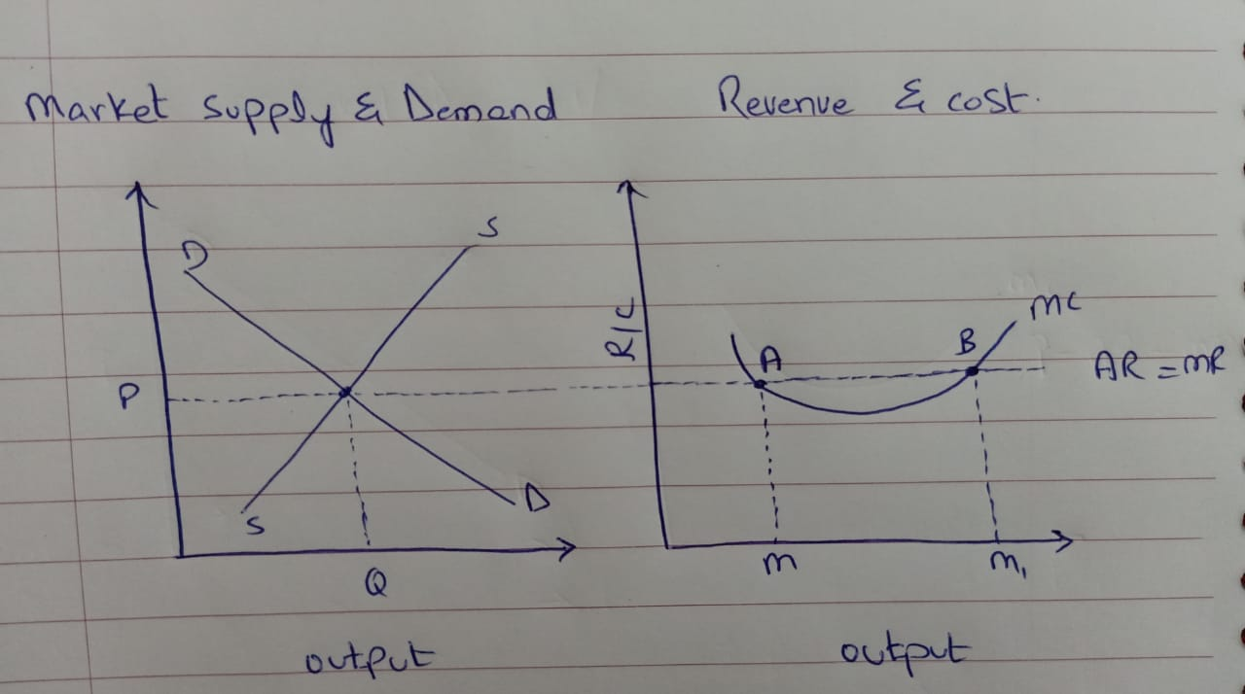
Graph

Slide 15
Explanation
In the short run, the interaction between demand and supply determines the “market-clearing" price
This price is taken by each firm
The average revenue curve is their individual demand curve
Since the market price is constant for each unit sold, the AR curve also becomes the marginal revenue curve (MR) for a firm in perfect competition
Since all units are equally priced, the MR curve is a horizontal line and is equal to the AR line. Observe that the curve MC cuts the MR curve at two points – A and B. At point A, the MC curve cuts the MR curve from above whereas at point B it cuts the MR curve from below. Therefore, according to the conditions of equilibrium of a firm, point B is the point of equilibrium(when MC curve cuts MR from below) and M1 is the equilibrium level of output.

Slide 16
Possibilities of firms equilibrium in short run
There are 4 possibilities of firm’s equilibrium in short run.
Super normal profit/Abnormal profit
Normal profit
Loss/Normal loss
Shut Down point/abnormal loss

Slide 17
1. Supernormal profit
Supernormal profit is all the excess profit a firm makes above the minimum return necessary to keep a firm in business.
Supernormal profit is calculated by Total Revenue – Total Costs (where total cost includes all fixed and variable costs, plus minimum income necessary for the owner to be happy in that business.)
Supernormal profit is defined as extra profit above that level of normal profit.
Supernormal profit is also known as abnormal profit. Abnormal profit means there is an incentive for other firms to enter the industry.

Slide 18
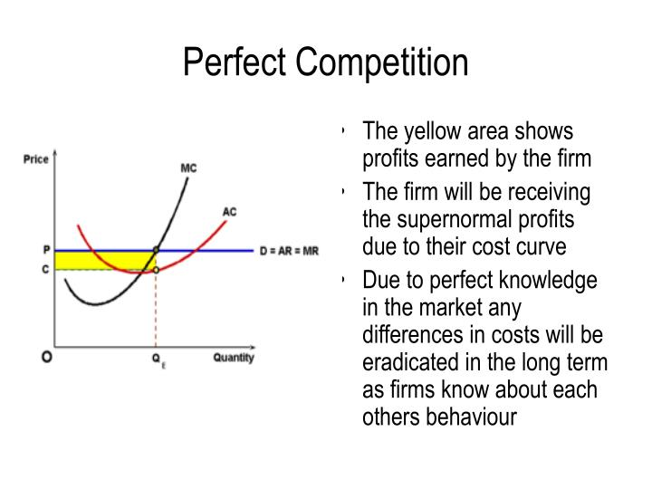

Slide 19
2. Normal profit
Normal profit is defined as the minimum level of profit necessary to keep a firm in that line of business. This level of normal profit enables the firm to pay a reasonable salary to its workers and managers. The definition of normal profit occurs when AR=ATC (average revenue = average total cost)
Normal profit is a situation where a firm makes sufficient revenue to cover its total costs and remain competitive in an industry.
When a firm makes normal profit we say the economic profit is zero.
Normal profit = total revenue – total costs
Where total costs =
Explicit costs (rent, labour costs, raw materials +)
Implicit costs (opportunity cost of capital/working elsewhere)

Slide 20
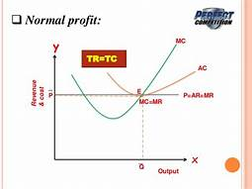

Slide 21
3. Loss
When price is less than average total cost, the firm is making a loss in the market.

Slide 22
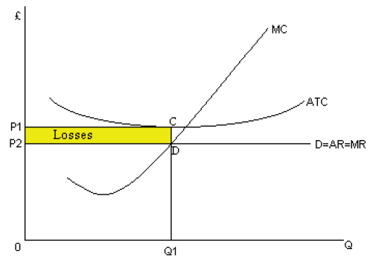

Slide 23
Abnormal loss
An abnormal loss refers to a situation where a business or firm is making profits below the normal limits. In an abnormal loss situation the total revenue of a business does not cover total cost incurred for the business.
A shutdown point is a level of operations at which a company experiences no benefit for continuing operations and therefore decides to shut down temporarily (or in some cases permanently). It results from the combination of output and price where the company earns just enough revenue to cover its total variable costs

Slide 24
